Slide 1
Employee Data Analysis using Excel
STUDENT NAME : Harshini. A
REGISTER NO : 312209415
DEPARTMENT : B Com Accounting and Finance
COLLEGE : Anna Adarsh College For Women
NM ID:

Slide 2
PROJECT TITLE
Employee Performance Analysis using Excel

Slide 3


AGENDA
Problem Statement
Project Overview
End Users
Our Solution and Proposition
Dataset Description
Modelling Approach
Results and Discussion
Conclusion
3/21/2024 Annual Review

Slide 4

PROBLEM STATEMENT
In today's diverse workforce, it's crucial to understand how gender is distributed across various employment types to address potential disparities and ensure equitable practices. XYZ Co. aims to analyze gender distribution across different employment categories to identify any biases or gaps in opportunities, ultimately fostering a more balanced and inclusive work environment.

Slide 5

PROJECT OVERVIEW
.
A data analytics project entails gathering, analyzing, and interpreting data to extract insights and facilitate informed decision-making.
An analysis is a thorough examination of a subject, involving research and the breakdown of findings into smaller, logical components to draw well-founded conclusions. It presents a clear argument on the topic, supported by evidence to substantiate the claims.

Slide 6

WHO ARE THE END USERS?
Manager
Consumers
HR of the company
Employer
Employee
Other members of the organisation

Slide 7

OUR SOLUTION AND ITS VALUE PROPOSITION
FILTERING: REMOVE BLANK CELLS
FILL COLOR: HIGHLIGHT USED ROWS
PIVOT TABLE: SUMMARY OF EMPLOYEE DATASET
PIVOT CHART: VISUALIZE SUMMARY OF EMPLOYEE DATASET

Slide 8
Dataset Description
Employee ID: Unique identifier for each employee in the organization.
First Name: The first name of the employee.
Last Name: The last name of the employee.
Start Date: The date when the employee started working for the organization.
Exit Date: The date when the employee left or exited the organization (if applicable).
Title: The job title or position of the employee within the organization.
Supervisor: The name of the employee's immediate supervisor or manager.
Email: The email address associated with the employee's communication within the organization.
BusinessUnit: The specific business unit or department to which the employee belongs.
Employee Status: The current employment status of the employee (e.g., Active, On Leave, Terminated).
Employee Type: The type of employment the employee has (e.g., Full-time, Part-time, Contract).
Pay Zone: The pay zone or salary band to which the employee's compensation falls.
Employee Classification Type: The classification type of the employee (e.g., Exempt, Non-exempt).

Slide 9
Dataset Description
Termination Type: The type of termination if the employee has left the organization (e.g., Resignation, Layoff, Retirement).
Termination Description: Additional details or reasons for the employee's termination (if applicable).
Department Type: The broader category or type of department the employee's work is associated with.
Division Description: The division or branch of the organization where the employee works.
DOB (Date of Birth): The date of birth of the employee.
State: The state or region where the employee is located.
Job Function: A brief description of the employee's primary job function or role.
Gender: A code representing the gender of the employee (e.g., M for Male, F for Female, N for Non-binary).
Location: A code representing the physical location or office where the employee is based.
Race (or) Ethnicity: A description of the employee's racial or ethnic background (if provided).

Slide 10
Dataset Description
Marital Status: The marital status of the employee (e.g., Single, Married, Divorced).
Performance Score: A score indicating the employee's performance level (e.g., Excellent, Satisfactory, Needs Improvement).
Current Employee Rating: The current rating or evaluation of the employee's overall performance.

Slide 11
MODELLING
DATA COLLECTION:THE DATA COLLECTION WAS DOWNLOAD IN “KAGGLE”.
FEATURE COLLECTION:IN THIS DATA BASE IT HAS 11 FEATURES I HAD USE 8 FEATURS OF MY PROJECTS.
DATA CLEANING:IN THIS STEP I HAD IDENTIFY THE MISSING VALUE AND REMOVE THE BLANK.
PERFOMANCE LEVEL:I HAD CALCULATE THE EMPLOYEE DATA BY USING FORMULA =IFS(J4>5,"high ",J4>3,"med","true","low")
SUMMARY:FOR MY PROJECT I HAD USE PIVOT TABLES FOR EMPLOYEE DATA ANALYSIS.
I HAVE USED SLICER TOOL IN ORDER TO CLASSIFY EMPLOYEES ON THE BASIS OF CONTRACT- FULL TIME AND PART TIME iyt
VISUALIZATION:FOR MY PROJECT I HAD USE TO VISULIZED MY EMPLOYEE DATA ANALYSIS AS “GRAPH”.
11

Slide 12
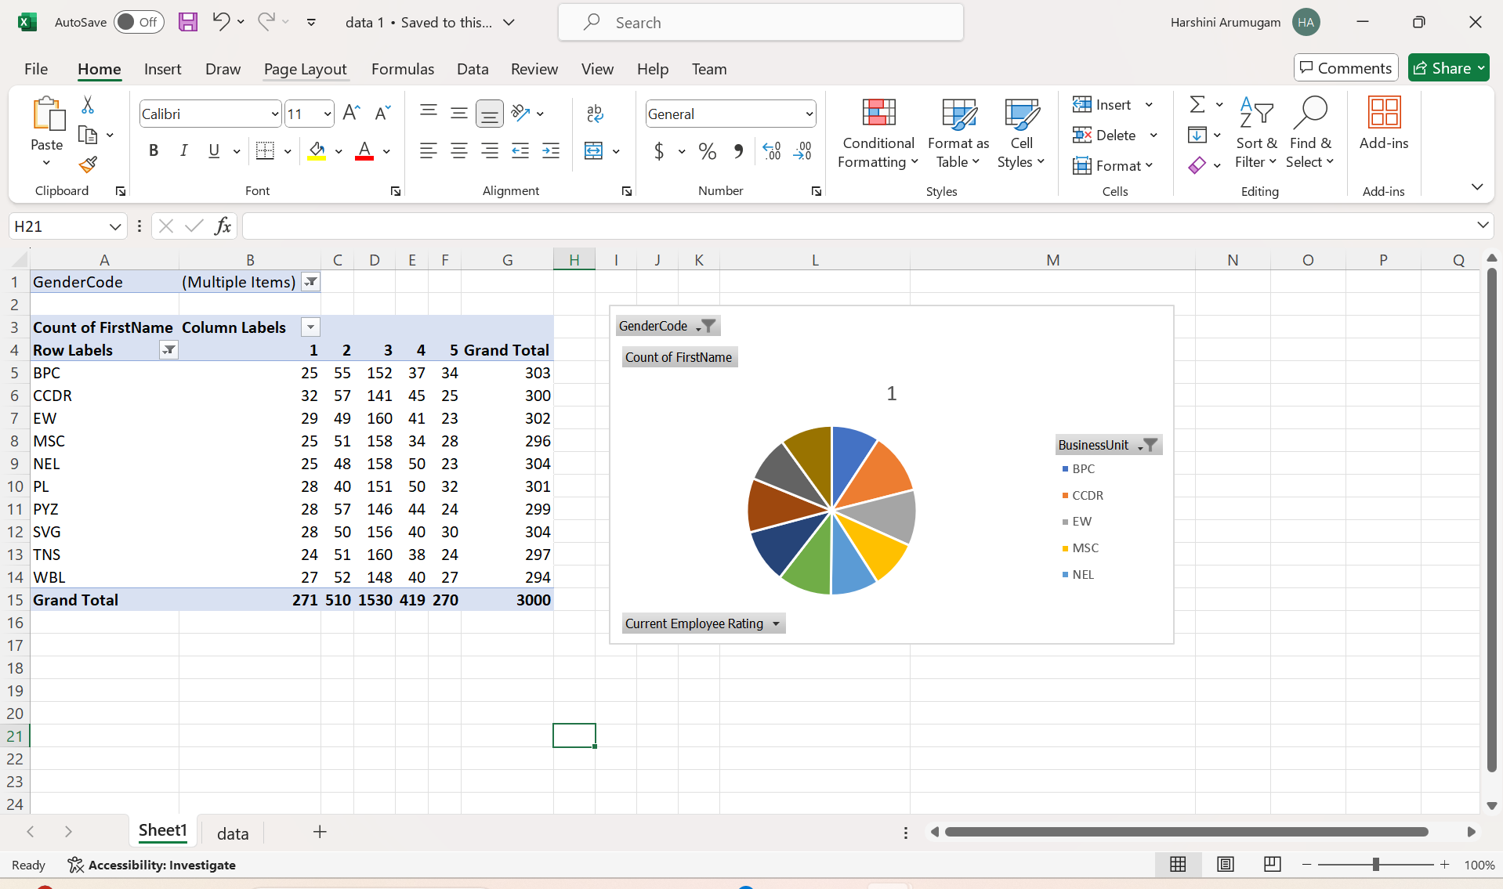
RESULTS
12

Slide 13
conclusion
The gender distribution analysis has provided valuable insights into the current state of gender representation across various employment types. By identifying potential biases and gaps, the project has highlighted areas where improvements can be made to foster a more equitable and inclusive workplace.
The recommendations and strategies developed through this analysis serve as a roadmap for promoting gender equity. Implementing these changes will enhance diversity, ensure fair opportunities for all employees, and strengthen the commitment to creating a balanced and supportive work environment.
Moving forward, continuous monitoring and evaluation will be essential to maintain progress and address any emerging disparities. By prioritizing equity and inclusion, the organization is well-positioned to build a more diverse, innovative, and successful workplace.

